Slide 1
CUDA Performance
Memory Models and Streams

Slide 2
Memory
So far, we have only referenced the big block of memory that was copied from main memory to the GPU.
There are other memory types in the GPU that we should understand – they can have a significant performance impact.
Much like CPUs, accessing main memory is slow.
Of course, GPUs have much faster main memory than CPUs.

Slide 3
Memory – register and local
In our kernel, our scalar local variables will be register values, much like a CPU. Of course, there is a limit to the number of registers.
Local arrays are stored in main memory and will incur the same performance penalty as accessing other main memory. They will, however, be automatically allocated and deallocated for us on a thread-by-thread basis.

Slide 4
Memory - shared
Shared memory is stored at the block level. Accessing an item in shared memory will give the same value for any thread in the block.
This gives us the ability to share data between threads at the block granularity. This memory is automatically allocated and freed for us.
Inside the kernel:
__shared__ int someSharedVariable; // shared for the whole block

Slide 5
Memory - constant
CUDA gives us the ability to have a limited number of read-only constants. These are extremely fast and parallel. They are limited in size (64k is a safe bet).
They are declared outside of any function in C:
__constant__ float pi=3.14159;

Slide 6
Memory - globals
We saw global values allocated through cudaMalloc and passed as parameters to our kernels.
We can similarly declare global variables that are shared by all of the kernels in the system:
__device__ int everyoneCanSeeMe;

Slide 7
Memory - managed
Managed memory is visible from both CPU and GPU functions.
Example:
__device__ __managed__ int everywhere = 10;
__device__ func() {
everywhere=20; }
void main () {
everywhere = 30;
func<<<1,1>>>();}

Slide 8
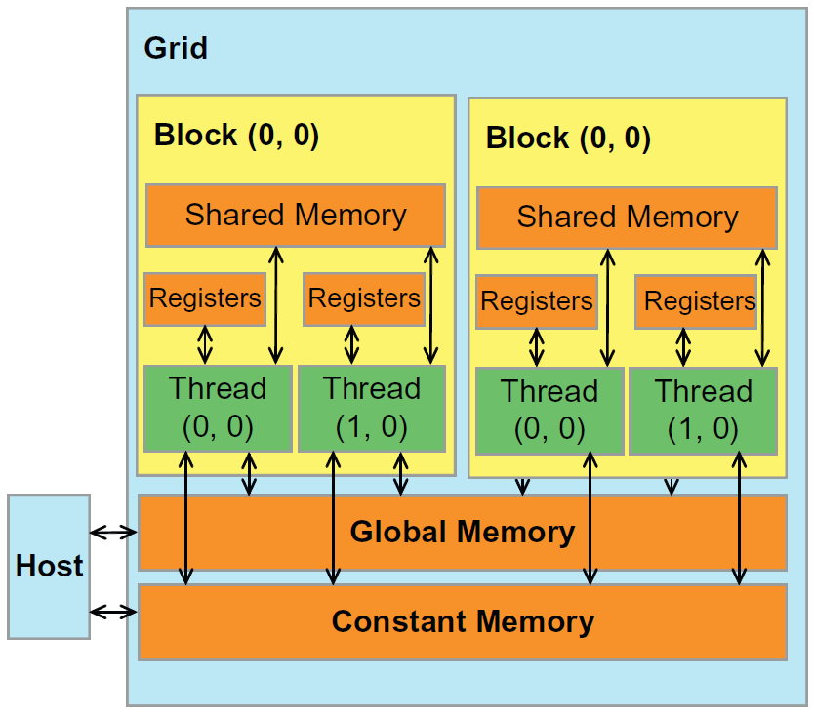
Memory Summary
Declaration | Memory Type | Scope | Lifetime
local variables, not arrays | register | thread | kernel
local arrays | local (global in reality) | thread | kernel
__shared__ | shared | block | kernel
__device__ | global | grid | application
__constant__ | constant | grid | application
__managed__ | global | grid | application

Slide 9
Performance of shared memory
Shared memory is stored near the CPU and is much faster than global memory.
You should prefer shared memory for working with data that is common to your block.

Slide 10
Previous blur example kernel code:
__global__ void blurKernel(float *a, float *b, float *c, int n) {
int id = threadIdx.x + blockDim.x * blockIdx.x;
if (id < n) c[id] = a[id] + b[id];
__syncthreads(); // c is calculated for this whole block
if (id < n) temp = c[id] + c[id+1] + c[id-1];
__syncthreads(); // temp is calculated for this whole block
if (id < n) c[id] = temp/3; // now it’s safe to change c
}
Note that we aren’t checking id+1/id-1 for safety…

Slide 11
Improved blur kernel
__global__ void blurKernel(float *a, float *b, float *c, int n) {
int id = threadIdx.x + blockDim.x * blockIdx.x;
__shared__ float temp[blockDim.x];
if (id < n)
temp[threadIdx.x] = a[id] + b[id];
__syncthreads(); // temp is calculated for this whole block
if (id < n)
c[id] = (temp[threadIdx] +
temp[threadIdx-1] +
temp[threadIdx+1]) /3;
}

Slide 12
Performance Of Constants
Like shared memory, constants are much faster than global memory.
Because they are read-only, the GPU hardware can make optimizations. For example – shared memory must be cleared between blocks. Constants do not need to be cleared.
In fact, constants are stored in global memory, but the caching subsystem (yes, just like on a CPU!) can optimize accesses.

Slide 13
Alignment
Much like CPUs, GPUs have alignment requirements for best performance.
We saw cudaMalloc and cudaFree, already.
For 2D and 3D arrays, we should use cudaMallocPitch() and cudaMalloc3D(). These pad the allocations for alignment.
Failure to do so can reduce performance.

Slide 14
cudaMallocPitch example
main () {
size_t pitch; float *mem;
cudaMallocPitch(&device, &pitch, width*sizeof(float),height);
myKernel<<<100,100>>> (mem, pitch, width, height);
}
__global__ void myKernel (float *mem, size_t pitch, int w, int h) {
for (int row = 0;row<h;row++)
float *row = mem+ row*pitch;
for (int col=0;col<w;col++)
float value=row[col];
}

Slide 15
cudaMalloc3D (with extent)
void main() { // int w, h, d = width, height, depth
cudaExtent e = make_cudaExtent(w*sizeof(float),h,d);
cudaPitchedPtr matrix;
cudaMalloc3D(&matrix, e);
myKernel<<<100,100>>>(matrix, w,h,d);
}
__global__ void myKernel(cudaPitchedPtr m, int w, int h, int d) {
for (int z=0;z<d;z++) {
char *slice = m.ptr + z * m.pitch * h; // pitch = rowSize
for (y=0;y<h;y++) {
float *row = slice + y * m.pitch;
for (x=0;x<w;x++)
float e = row[x];
} }}

Slide 16
Execution Model
We have talked extensively about grids of blocks and blocks of threads.
We mentioned, some time ago, the concept of warps. Now let’s tie those together.
A GPU has a number of execution units (much like cores in a CPU).
A warp is a set of execution units that all share the same PC and work on one group of threads at a time.

Slide 17
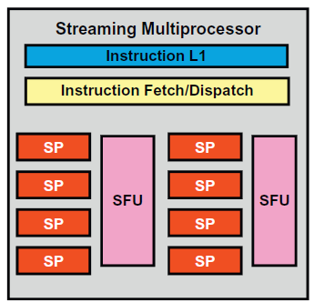
GPU
Global Memory
Streaming Processor
Special Function Unit
Grid
Block
Block
Thread
Thread
Thread
Thread
Thread
Thread
Thread
Thread
Thread
Thread
Thread
Thread
Block
Block
Thread
Thread
Thread
Thread
Thread
Thread
Shared Memory
Thread
Thread
Thread
Thread
Thread
Thread
Thread Execution Manager
Grid
Block
Block
Thread
Thread
Thread
Thread
Thread
Thread
Thread
Thread
Thread
Thread
Thread
Thread
Shared Memory
Block
Block
Thread
Thread
Thread
Thread
Thread
Thread
Thread
Thread
Thread
Thread
Thread
Thread
More SM’s…
Logical Organization
Physical Organization

Slide 18
GPU
Global Memory
Grid
Thread manager feeds one block into the SM. The block is broken down into warps – groups of 32 threads.
Block
Block
Thread
Thread
Thread
Thread
Thread
Thread
Thread
Thread
Thread
Thread
Thread
Thread
Block
Block
Thread
Thread
Thread
Thread
Thread
Thread
Shared Memory
Thread
Thread
Thread
Thread
Thread
Thread
Thread Execution Manager
Grid
Block
Block
Thread
Thread
Thread
Thread
Thread
Thread
Thread
Thread
Thread
Thread
Thread
Thread
Shared Memory
Block
Block
Thread
Thread
Thread
Thread
Thread
Thread
Thread
Thread
Thread
Thread
Thread
Thread
More SM’s…
Logical Organization
Physical Organization

Slide 19
GPU
Global Memory
All threads share the same PC/instruction fetch. In the case of an “if”, the threads that take the “then” case proceed, then the threads that take the “else” case.
Grid
Block
Block
Thread
Thread
Thread
Thread
Thread
Thread
Thread
Thread
Thread
Thread
Thread
Thread
Block
Block
Thread
Thread
Thread
Thread
Thread
Thread
Shared Memory
Thread
Thread
Thread
Thread
Thread
Thread
Thread Execution Manager
Grid
Block
Block
Thread
Thread
Thread
Thread
Thread
Thread
Thread
Thread
Thread
Thread
Thread
Thread
Shared Memory
Block
Block
Thread
Thread
Thread
Thread
Thread
Thread
Thread
Thread
Thread
Thread
Thread
Thread
More SM’s…
Logical Organization
Physical Organization

Slide 20
GPU
Global Memory
Note that there are 8SPs (streaming processors), while the warp is 32 threads. When a thread has to wait (say, for a memory access), other threads run.
Grid
Block
Block
Thread
Thread
Thread
Thread
Thread
Thread
Thread
Thread
Thread
Thread
Thread
Thread
Block
Block
Thread
Thread
Thread
Thread
Thread
Thread
Shared Memory
Thread
Thread
Thread
Thread
Thread
Thread
Thread Execution Manager
Grid
Block
Block
Thread
Thread
Thread
Thread
Thread
Thread
Thread
Thread
Thread
Thread
Thread
Thread
Shared Memory
Block
Block
Thread
Thread
Thread
Thread
Thread
Thread
Thread
Thread
Thread
Thread
Thread
Thread
More SM’s…
Logical Organization
Physical Organization

Slide 21
Wait – it gets more complicated…
An SM can hold more than one block at a time! This massive queue of work ensures that the SPs are always busy. This hides high latency operations like memory fetches.
The good news is that the GPU handles all of this management on its own.
But, the bad news? You still have to think a little about it…

Slide 22
Resource Management
Registers and shared memory reside on the SM. They are shared among all the threads on that SM.
The thread manager won’t put more threads on an SM than it can handle.
But that means that if your threads use a lot of registers or shared memory, the SM could have too few threads to keep the SPs busy.

Slide 23
Where this gets complicated
Using too few local resources (shared memory/registers) can make your algorithm slower (overuse of global memory).
Using too many local resources (shared memory/registers) can make your SM under scheduled and therefore slower.
The resource counts depend on the particular hardware – there is no standard. A good threads/block value on one GPU might be a bad choice on another card.
And, of course, your program might not be the only one on the GPU…

Slide 24
Even More Concurrency
Why wait?

Slide 25
Remember this?
We allocate space for all of the data, then copy the source data over.
We “call” our __global__ function
We copy our results back to main memory
We free our gpu related memory
This list is very synchronous. We allocate memory. We copy memory. We tell the GPU to do work. When it returns, we get our results.
Consider – why should the CPU sit idle while all of this happens?

Slide 26
Use the CPU while the GPU works…
We allocate space for all of the data, then copy the source data over.
We “call” our __global__ function
DoSomeCPUWork();
We copy our results back to main memory
We free our gpu related memory
Adding some CPU work while the GPU is working gives us another level of parallelism!

Slide 27
A bit of operating systems
Operating systems can “page” memory. When the system gets short on memory, it can write (part or all) of your program’s memory to disk. When you attempt to access that memory, the operating system must load the data back into memory.
Think of this like borrowing from one friend to pay a debt to another.
When paging happens, the physical location of your memory can change. The operating system and CPU make this seamless to your program, but the GPU can see the change.

Slide 28
Pinning (page-locking) memory
cudaHostAlloc() and cudaFreeHost() will allocate memory that cannot be paged.
cudaHostRegister() page-locks memory that was allocated by malloc
Once the memory is page-locked, the CUDA system has some more options available.
Why? Because it can be sure that the physical location of the memory won’t change “randomly”.

Slide 29
Advantages of page-locked memory
Copies from system memory to GPU memory can be performed while other kernels are running (on some GPUs)
On some GPUs, page-locked memory doesn’t even need to be copied to the GPU!
Some systems can optimize the bandwidth between system memory and GPU memory when the system memory is page-locked.

Slide 30
Sharing memory with the GPU
allocate pinned memory on the host to hold “size” floats. Write_combined is a flag indicating that the memory should not be cached by the CPU.
void *host_a,*dev_a;
int size=10000;
cudaHostAlloc((void**)&host_a,
size*sizeof(float),
cudaHostAllocWriteCombined |
cudaHostAllocMapped );
cudaHostGetDevicePointer( &dev_a, host_a, 0);
myKernel<<<100,100>>> (dev_a);
Get the pointer for the device from the host pointer

Slide 31
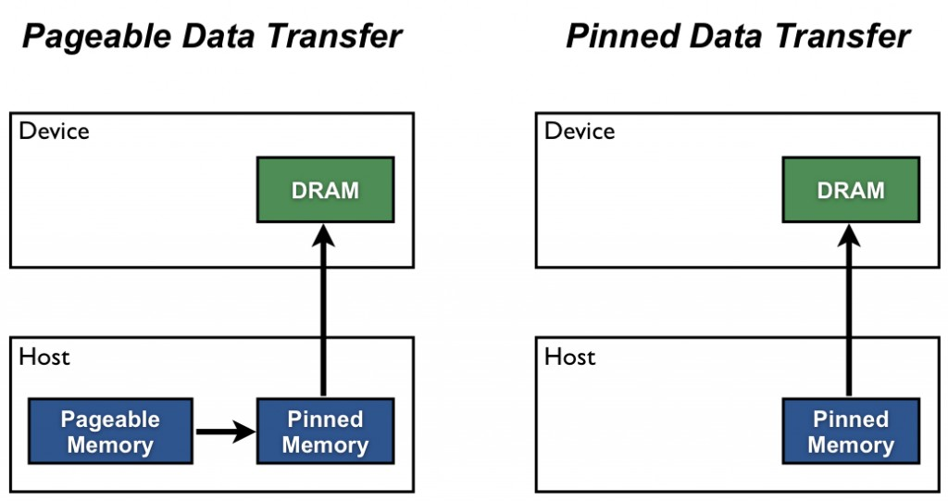
Downsides to shared memory
Pinned memory can’t be swapped out (can cause out of memory issues)
Shared memory isn’t as fast as GPU-local memory
If running the GPU and CPU simultaneously, contention for CPU-RAM can become an issue.

Slide 32
Streams
CUDA has a concept of streams – a sequence of operations that operate on the device in order.
There is a default stream (the null stream) that we have been using so far.
This default stream was why our “memcpy to GPU, call kernel, memcpy to CPU” didn’t start the memcpy while the GPU was executing the kernel. The stream ordering meant that we do one thing at a time.

Slide 33
Making streams
cudaStream_t stream1;
cudaError_t result;
result = cudaStreamCreate(&stream1);
result = cudaMemcpyAsync(d_a, a, N,
cudaMemcpyHostToDevice, stream1); //a must be pinned
someKernel<<<100,100,0,stream1>>>(d_a); // more about the 0 later
result = cudaStreamDestroy(stream1);

Slide 34
Two different approaches
One approach to using streams is to break the whole problem up into N pieces. Make N streams and have each stream do 1/N of the problem.
Another approach is to make N streams. Use all N streams to memcpy to the GPU, then all N streams execute parts of the kernel, then all N streams copy the result data to the CPU.
Which one is better depends on the model of the GPU.

Slide 35
Approach 1 – split the whole problem
for (int i = 0; i < nStreams; ++i) {
int offset = i * streamSize;
cudaMemcpyAsync(&d_a[offset], &a[offset], streamBytes, cudaMemcpyHostToDevice, stream[i]);
kernel<<<streamSize/blockSize, blockSize,
0, stream[i]>>>(d_a, offset);
cudaMemcpyAsync(&a[offset], &d_a[offset], streamBytes, cudaMemcpyDeviceToHost, stream[i]);
}

Slide 36
Approach 2 – split setup/execute/copy back
for (int i = 0; i < nStreams; ++i) {
int offset = i * streamSize;
cudaMemcpyAsync(&d_a[offset], &a[offset],
streamBytes, cudaMemcpyHostToDevice, stream[i]);
}

Slide 37
Approach 2 – split setup/execute/copy back
for (int i = 0; i < nStreams; ++i) {
int offset = i * streamSize;
kernel<<<streamSize/blockSize, blockSize, 0, stream[i]>>>(d_a, offset);
}

Slide 38
Approach 2 – split setup/execute/copy back
for (int i = 0; i < nStreams; ++i) {
int offset = i * streamSize;
cudaMemcpyAsync(&a[offset], &d_a[offset],
streamBytes, cudaMemcpyDeviceToHost, stream[i]);
}

Slide 39
Results?
Methodology | Device 1 | Device 2
Sequential | 12.9 ms | 10.0ms
Approach 1 | 13.6 ms | 5.7ms
Approach 2 | 8.8 ms | 7.6ms
Takeaway? You have to test on each device – you can’t know which will be better for your problem and your data on your device.

Slide 40
Take aways
Efficient use of different memory types can make our GPU code faster
Use the CPU while the GPU is busy
Parallelism using streams can make the GPU even more efficient!

